Slide 1
MPSeDC Training
PM Poshan
Social Audit
Training Module Covers:
✓ Web Portal – geoportal.mp.gov.in
✓ Mobile App – District GIS Parakh
✓ User Management (Super/Dept Admin)
✓ School List & Assignment
✓ Dynamic Form Creation
✓ Inspector Workflow
✓ Verification & Reports
District GIS – Parakh Platform
Web & Mobile Application Training
Government of Madhya Pradesh
Madhya Pradesh State Electronics Development Corporation (MPSeDC)
State IT Center, 47-A Arera Hills, Bhopal | www.mpsedc.mp.gov.in

Slide 2
Training Agenda
MPSeDC
PARAKH
PM Poshan Social Audit – Web & Mobile Platform
01
05
Platform Overview
User Creation
What is District GIS Parakh? Social Audit objectives
Form types, question setup, form visibility
02
06
Web Portal – Login & Dashboard
Mobile App – District GIS Parakh
geoportal.mp.gov.in/parakhweb/ | User roles
Login, school selection, data collection workflow
03
07
User Management
Inspector Workflow (App)
Super Admin → Dept Admin → Nodal → Inspector creation
Submit audit, photo capture, GPS, offline mode
04
08
School List & Assignment
Verification & Reports
Nominating schools for PM Poshan Social Audit
Web portal: verify surveys, export data, dashboard
MPSeDC | District GIS Parakh | PM Poshan Social Audit Training
2

Slide 3
01 Platform Overview
MPSeDC
PARAKH
District GIS Parakh – Social Audit for PM Poshan Scheme
What is District GIS Parakh?
Web Portal
District GIS Parakh is an MPSeDC platform for the Govt. of Madhya Pradesh that enables digital social audits of government schemes through web and mobile channels.
PM Poshan (Mid-Day Meal) Social Audit:
Inspectors visit schools and collect data on food quality, attendance, cooking arrangements, infrastructure, and beneficiary count to ensure scheme compliance.
geoportal.mp.gov.in/parakhweb/
• Admin panel for all user & form management
• School list, nomination & assignment
• Dashboard, reports & data verification
User Hierarchy
Super Admin –
Platform owner – creates Dept Admins
Department Admin –
Created by Super Admin; creates Nodal Officers
Mobile App – District GIS Parakh
Nodal Officer –
District-level; creates Reporting Officers
Available on Android
Reporting Officer –
Block-level; creates Inspectors
• Inspectors log in and select their assigned schools
• Fill dynamic audit forms with photos & GPS
• Works in low connectivity / offline mode
Inspector –
Field auditor – collects data via App
Citizen –
Public access for general forms
MPSeDC | District GIS Parakh | PM Poshan Social Audit Training
3

Slide 4
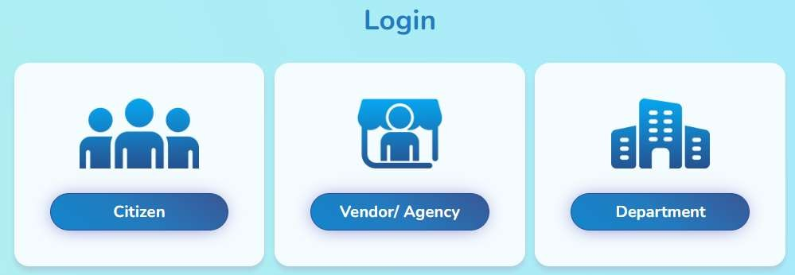
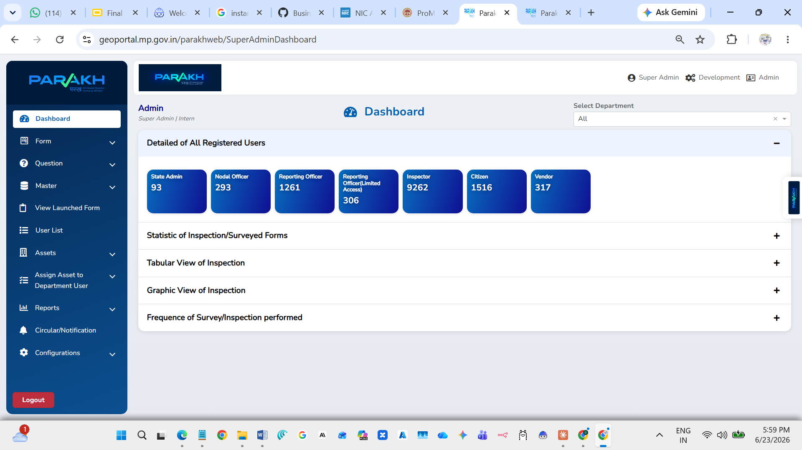
02 Web Portal – Login
MPSeDC
PARAKH
URL: https://geoportal.mp.gov.in/parakhweb/
Step 1: Open Web Browser
Navigate to: geoportal.mp.gov.in/parakhweb/
Step 2: Select Login Type
• Citizen – General public access • Vendor/Agency – Agency logins • Department – For Super Admin, Dept Admin, Nodal Officer, RO, Inspector
Super Admin Dashboard – User Statistics
For PM Poshan Social Audit – use DEPARTMENT login
Key Stats: 9,262 Inspectors | 1,261 Reporting Officers | 293 Nodal Officers
MPSeDC | District GIS Parakh | PM Poshan Social Audit Training
4

Slide 5
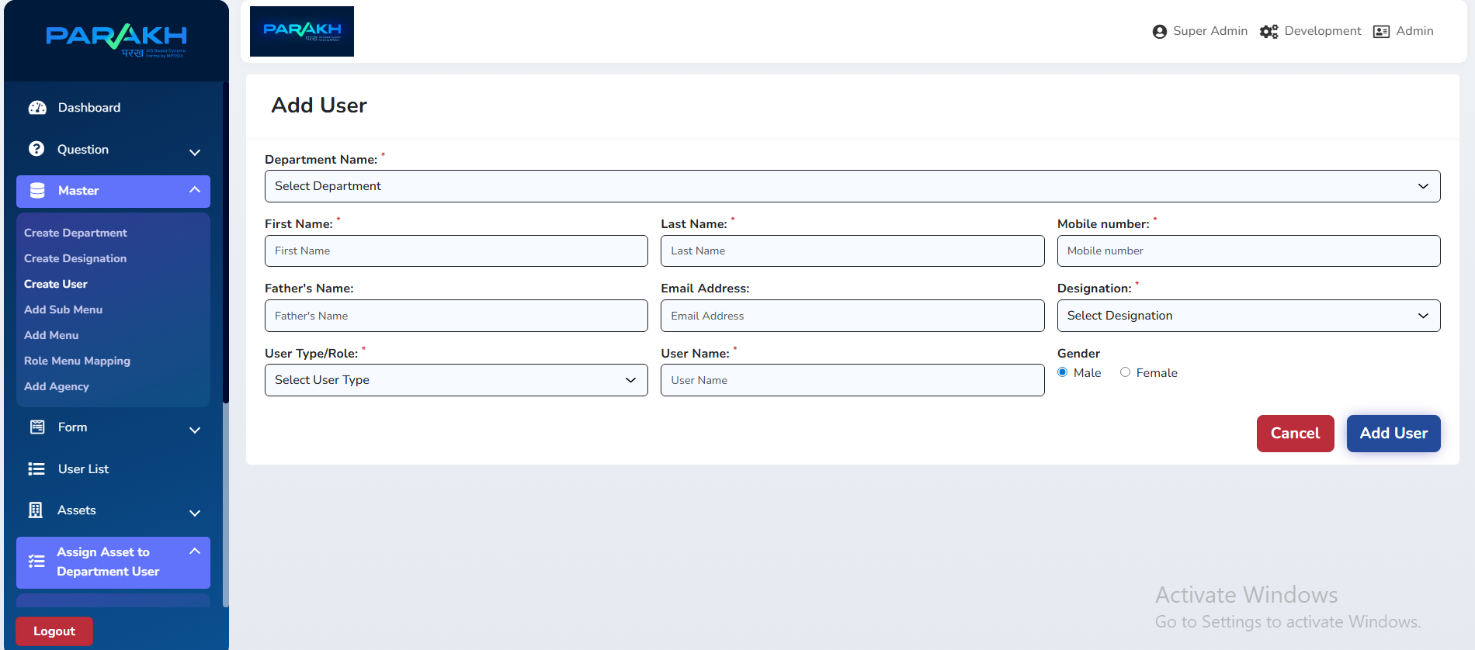
03 User Management – Step 1
MPSeDC
PARAKH
Super Admin Creates Department Admin
How Super Admin Creates Dept Admin
1
Login
Use Super Admin credentials (pmposhanadmin)
2
Navigate
Go to Master → Create User
3
Fill Form
Department, Name, Mobile, Email, Designation, User Type = Dept Admin
Add User Form – Web Portal (Master → Create User)
4
Username
Assign unique username & save
5
Department Admin logs in
Uses assigned credentials to set up their hierarchy
MPSeDC | District GIS Parakh | PM Poshan Social Audit Training
5

Slide 6
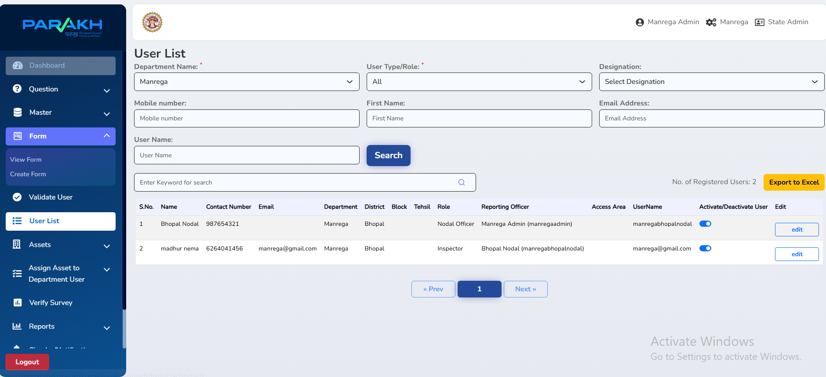
03 User Management – Step 2
MPSeDC
PARAKH
Department Admin Creates Nodal Officer & Inspector
Hierarchy Creation Flow
1
Dept Admin
Logs in → creates Nodal Officer at District level (e.g., Bhopal Nodal)
2
Inside Nodal
Nodal creates Reporting Officer at sub-district level
3
Reporting Officer
Creates Inspector (recommended: Inspector under RO)
User List – Department Admin View
4
Inspector
Receives assigned schools and uses the mobile app
⚠ Recommended: Create Inspectors under Reporting Officer (RO)
MPSeDC | District GIS Parakh | PM Poshan Social Audit Training
6

Slide 7
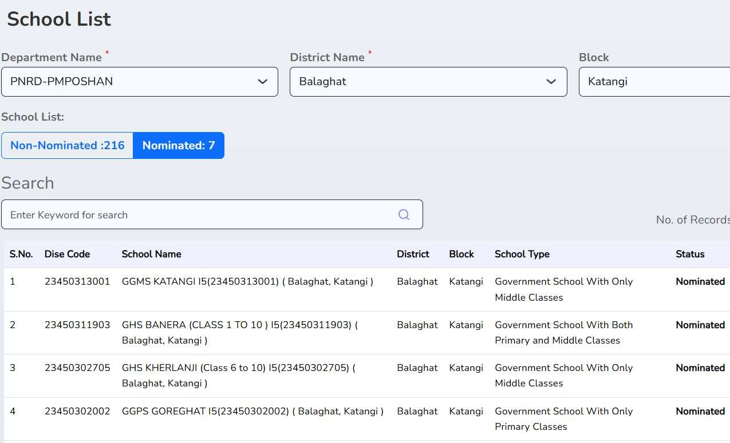
04 School List & Nomination
MPSeDC
PARAKH
View and Nominate Schools for PM Poshan Social Audit
How to Access School List
1
Select Department: PNRD-PMPOSHAN
2
Select District Name (e.g., Balaghat)
3
Select Block (e.g., Katangi)
4
View Non-Nominated vs Nominated schools
5
Search by keyword for specific schools
6
Click school row to Nominate for Social Audit
School List – Web Portal (PNRD-PMPOSHAN | Balaghat)
MPSeDC | District GIS Parakh | PM Poshan Social Audit Training
7

Slide 8
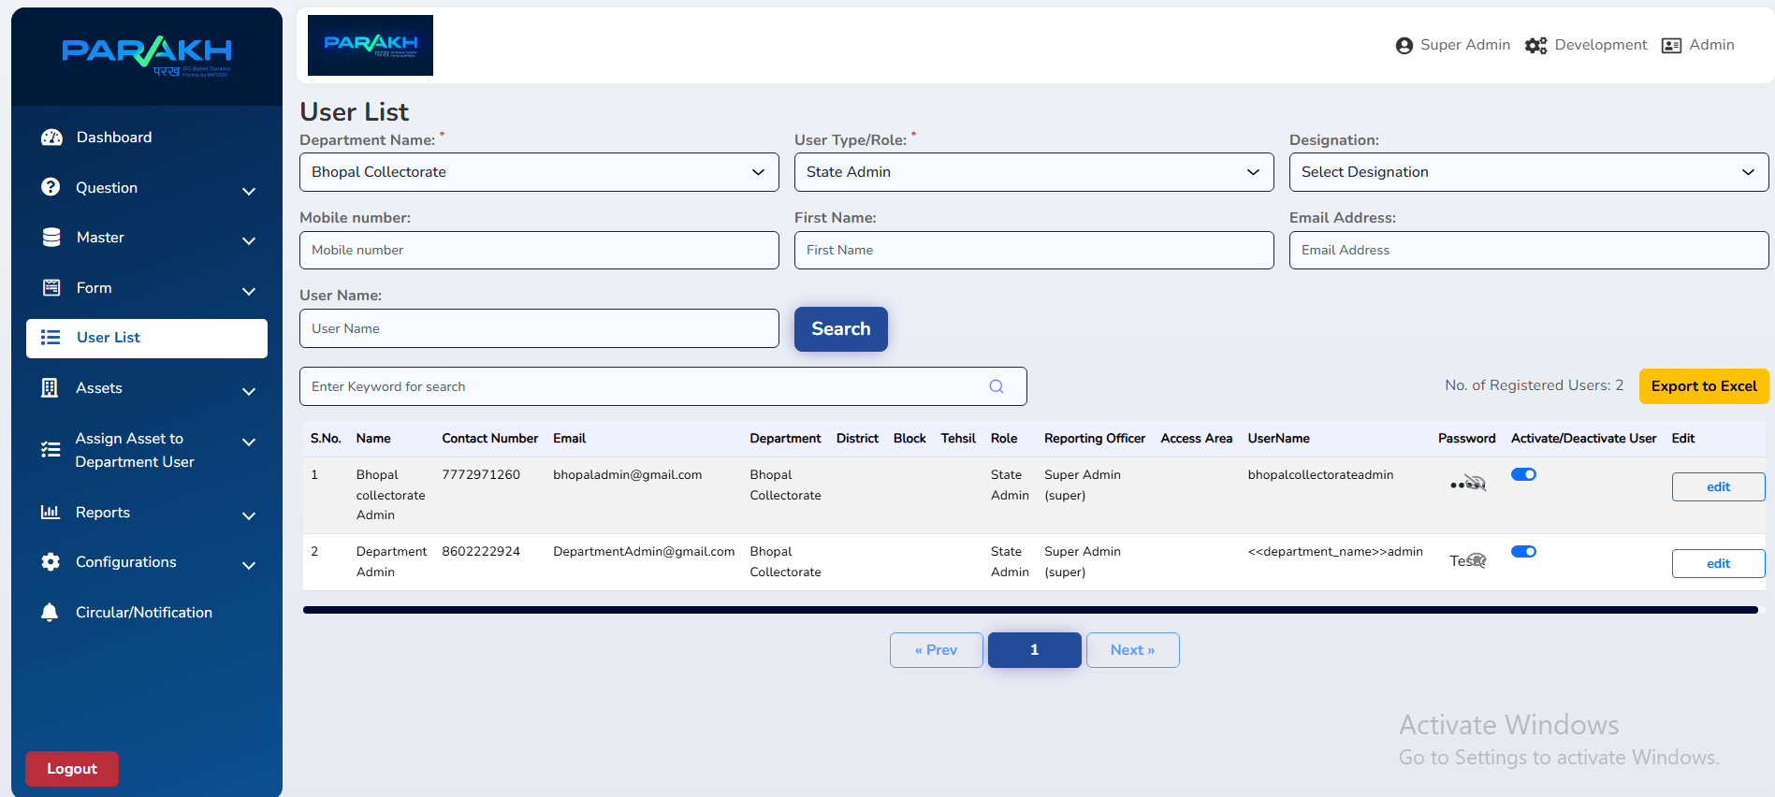
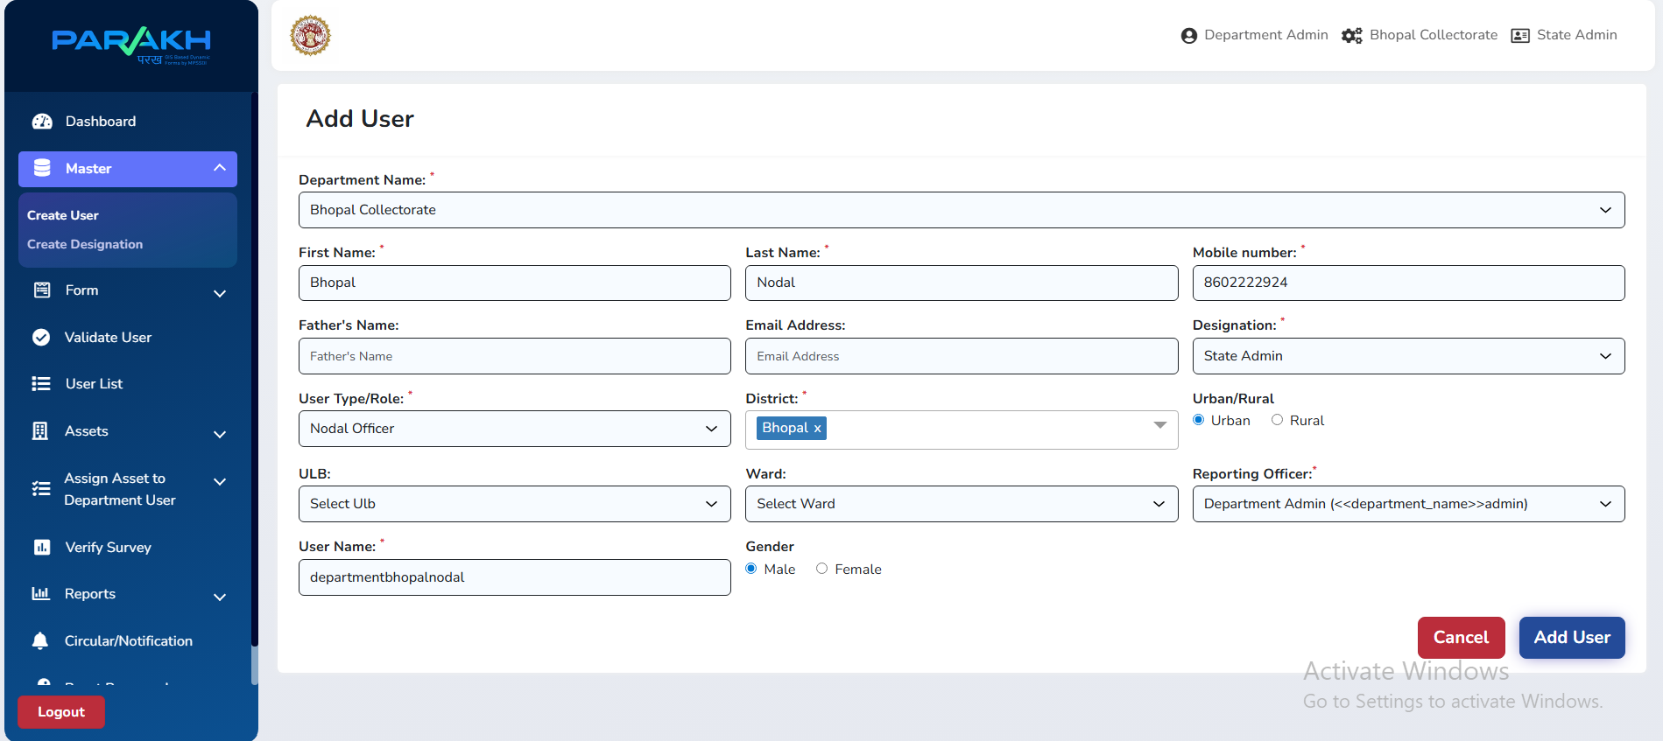
04 Assign School for Social Audit
MPSeDC
PARAKH
Assign Nominated Schools to Inspectors
Assign School to Inspector – Web Portal
Inspector receives schools in mobile app
Key Steps for School Assignment
1
Navigate to 'Assign Schools For Social Audit' in sidebar
2
Select Department = PNRD-PMPOSHAN and District
3
From Nominated schools list, select a school
4
Choose the Inspector from the dropdown
5
Click 'Assign' – Inspector can now see this school in their App
MPSeDC | District GIS Parakh | PM Poshan Social Audit Training
8

Slide 9
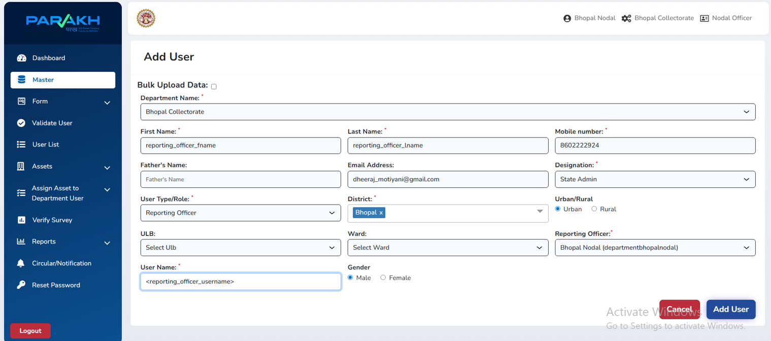
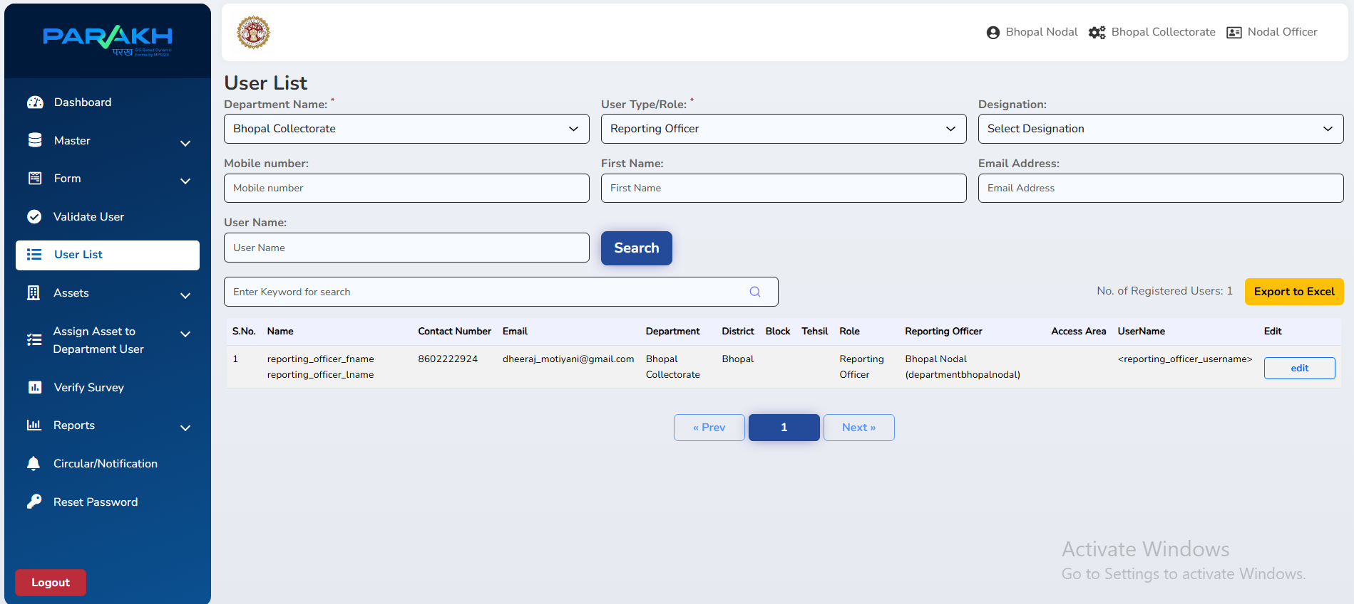
05 User Creation
MPSeDC
PARAKH
Admin creates Inspection Forms for PM Poshan Audit
Step 1: Select Form Type
Data Collection /
Survey Form
Department
General Form
Citizen
General Form
Inspection Form
Daily/Frequent – Inspectors collecting data on assets
For department-level inputs by Dept Admin/Nodal
Open for all citizens – public participation
Linked with Data Collection – one-time surveys per school
Form Navigation – Web Portal
Form List / Create Form
MPSeDC | District GIS Parakh | PM Poshan Social Audit Training
9

Slide 10
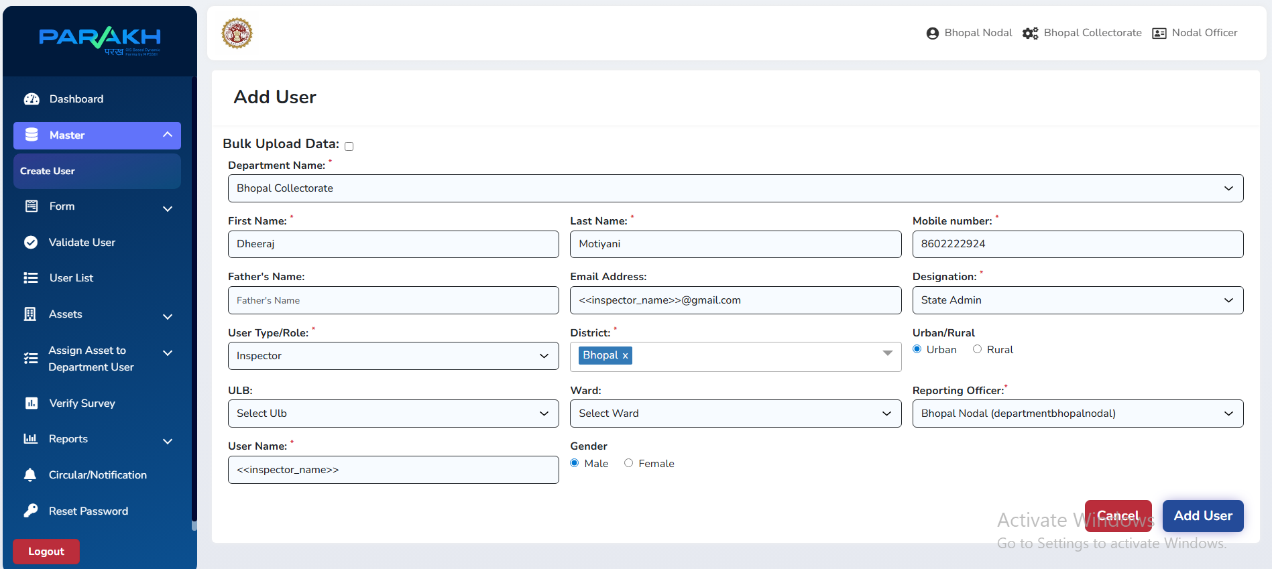
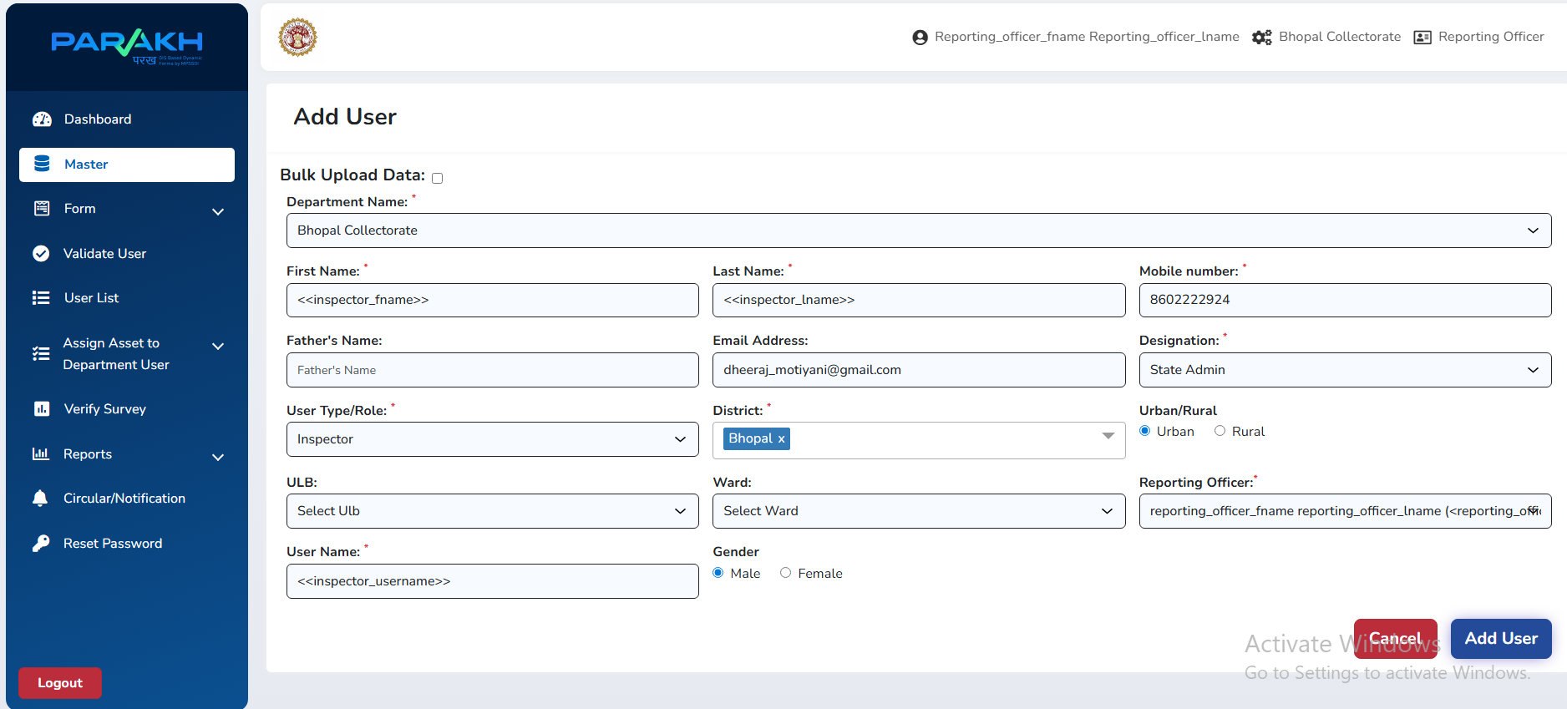
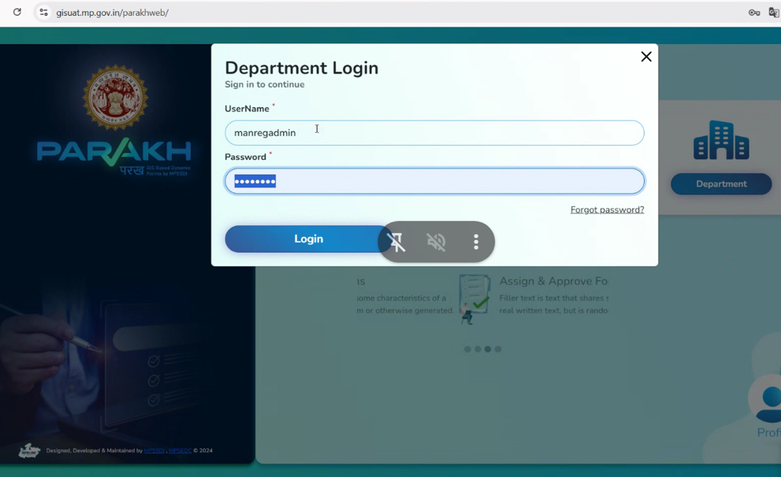
05 Form Creation – Question Setup
MPSeDC
PARAKH
Adding Main Questions and Sub-Questions
Create Question screen
Question list view
Step 1
Step 2
Step 3
Step 4
Step 5
Select Create Question
Add Main Question
Add Sub Questions
Set Question Type
Assign Visibility
In Form builder, click 'Create Question'
e.g. "Is the work completed on time?"
e.g. "If No, specify reason" – linked to parent
Text, Number, Yes/No, Date, Photo, GPS
Set who can see: Dept Users / Inspector / Citizens
MPSeDC | District GIS Parakh | PM Poshan Social Audit Training
10

Slide 11
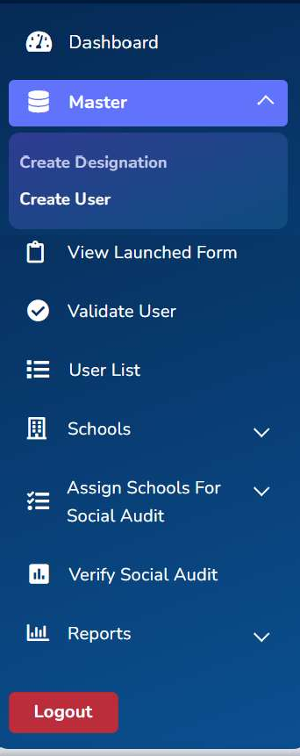
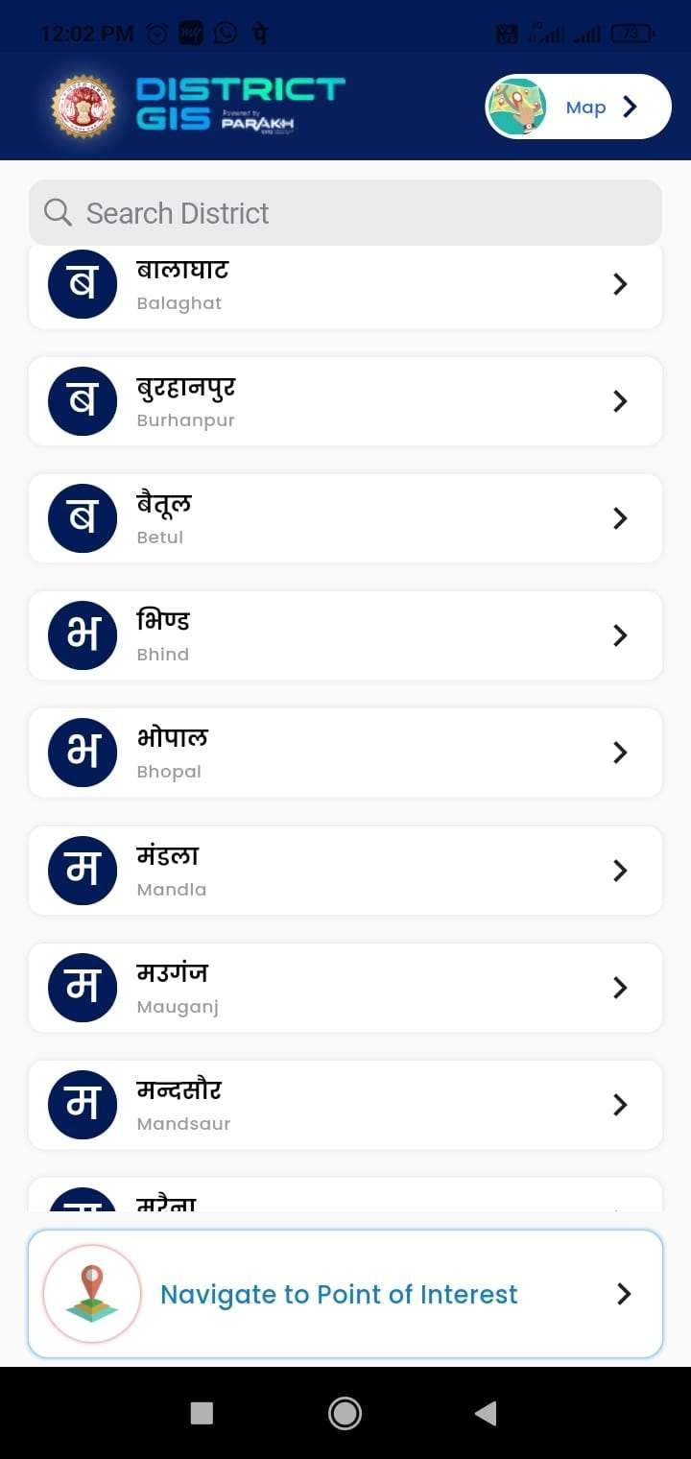
06 Mobile App – District GIS Parakh
MPSeDC
PARAKH
Inspector workflow on Android App
Inspector Steps on Mobile App
1
Download & Install
Install District GIS Parakh from Play Store or APK link provided by Dept Admin
2
Login
Use credentials created by Reporting Officer / Nodal Officer (Department login)
3
Select District
App shows districts; tap to select assigned district (e.g., Bhopal, Balaghat)
4
View Assigned Schools
Go to Schools → Assign Schools For Social Audit → your assigned schools appear
5
Start Social Audit Form
Tap school → open PM Poshan inspection form → fill all sections
6
Submit / Save
Submit completed form; GPS location and timestamps auto-captured
App Navigation Menu
District Selection
MPSeDC | District GIS Parakh | PM Poshan Social Audit Training
11

Slide 12
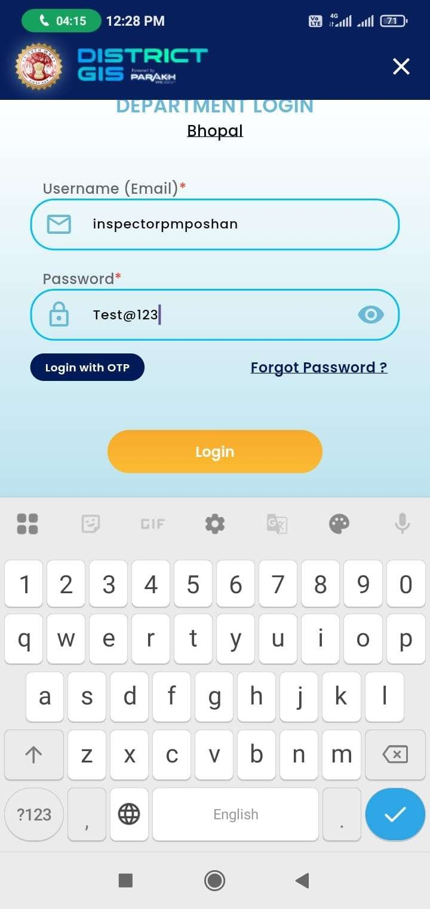
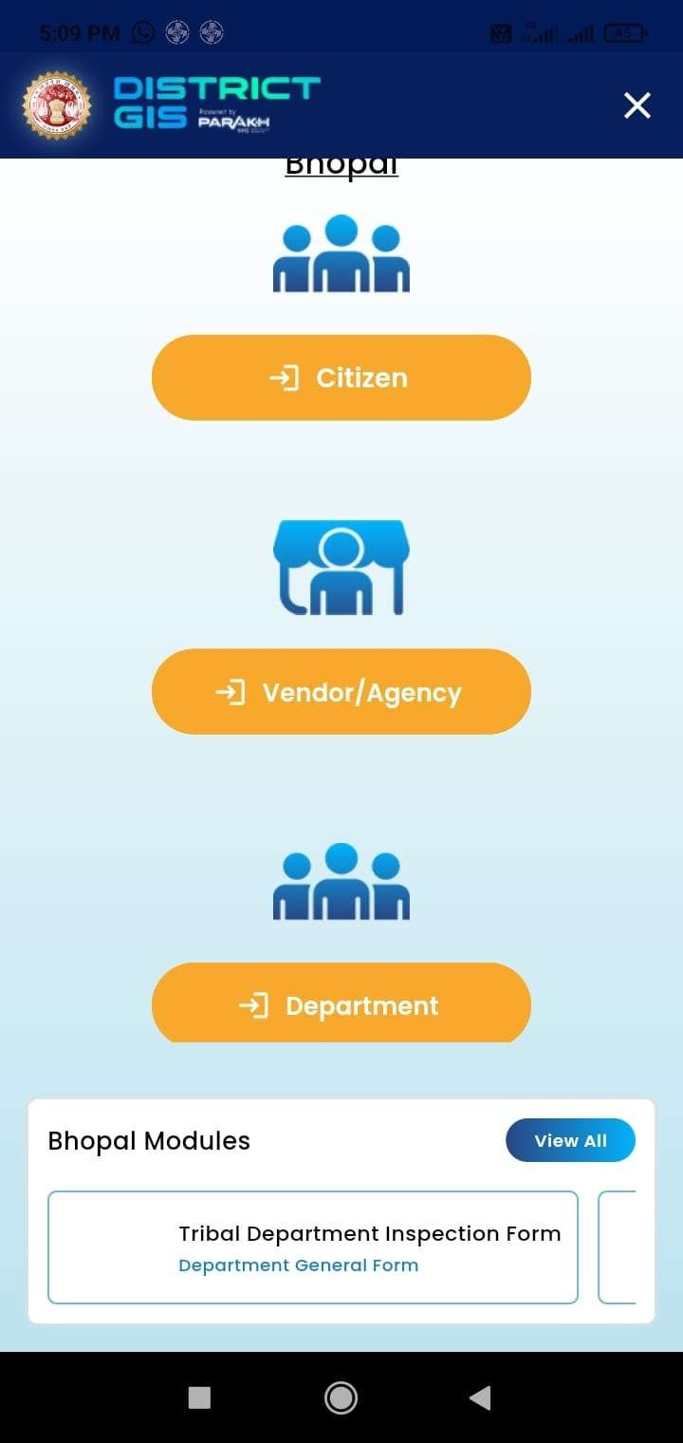
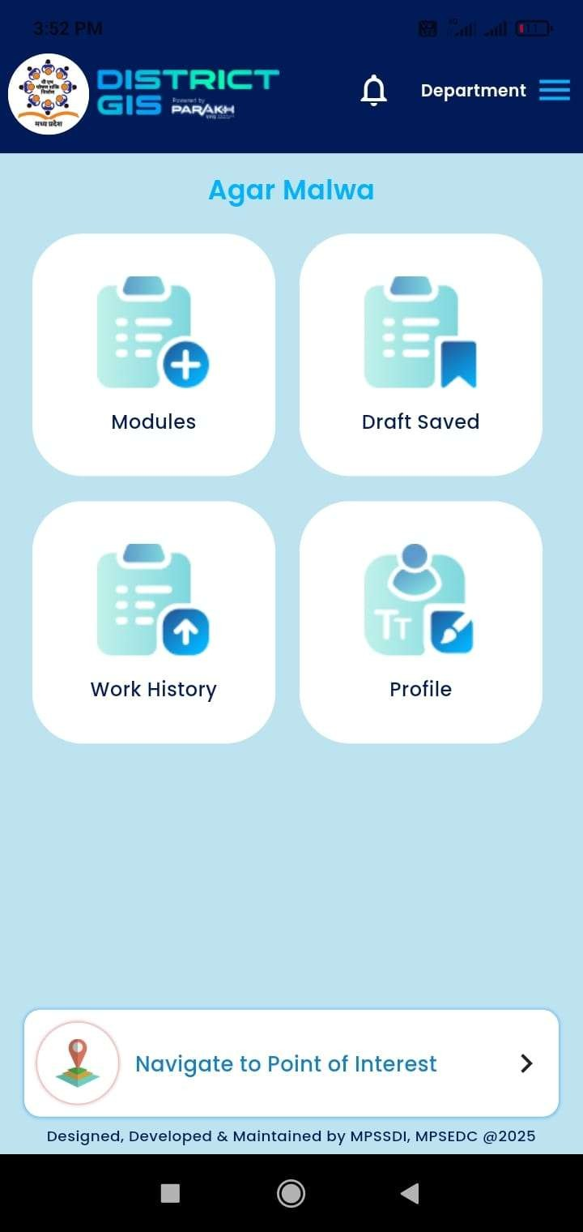
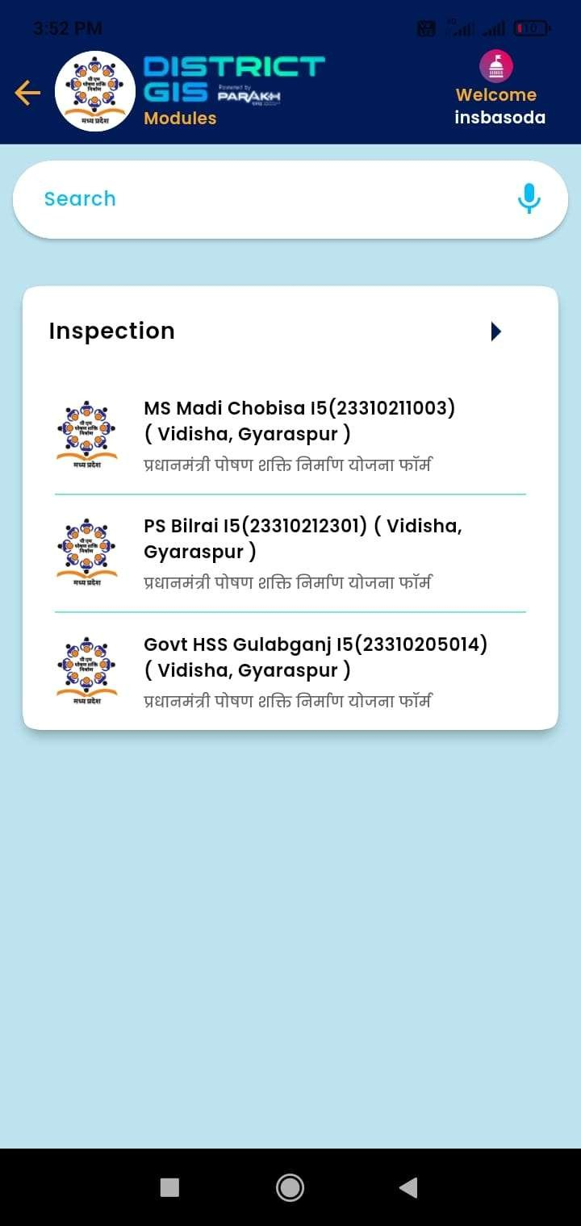
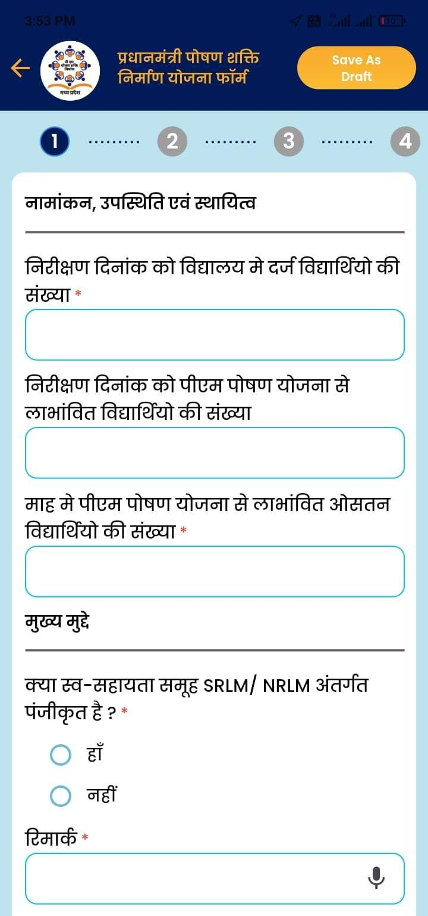
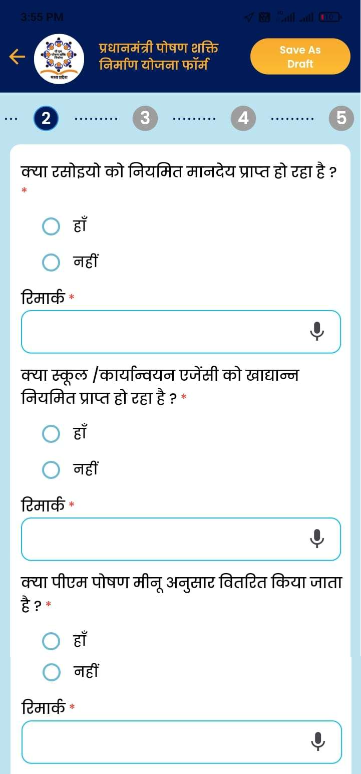
06 Mobile App – Key Screens
MPSeDC
PARAKH
PM Poshan Social Audit – Inspector Mobile Workflow
Login Screen
School Selection
Form Fill – Section 1
Form Fill – Section 2
Photo Capture
Form Submission
MPSeDC | District GIS Parakh | PM Poshan Social Audit Training
12

Slide 13
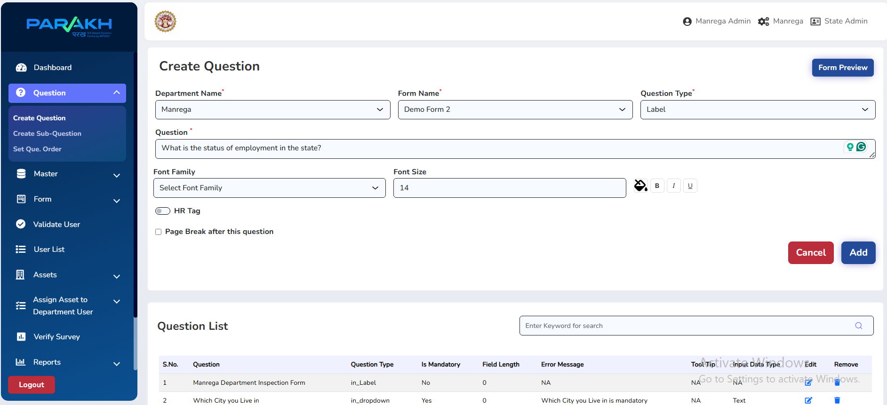
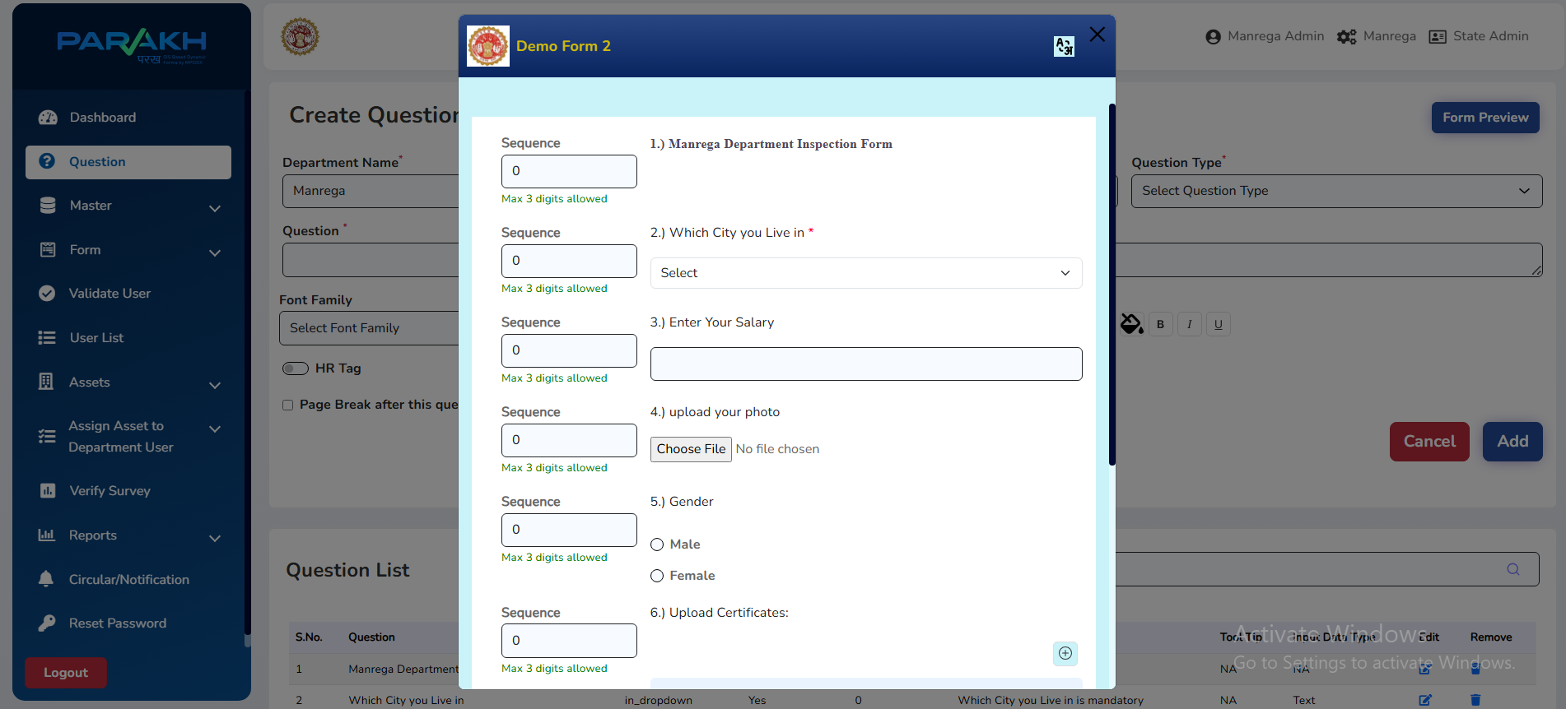
08 Verification & Reports
MPSeDC
PARAKH
Web Portal – Verify Surveys & Export Data
Verify Survey / Inspection
Reports & Export
Key Actions for Verifiers (Nodal Officer / RO)
Verify Survey
Approve / Reject
Go to Verify Survey/Inspection, select school, review submitted form data
Approve correctly filled forms or send back to Inspector with remarks
View Reports
Export to Excel
Reports section provides tabular/graphical summary of audits completed
Export audit data to Excel for further analysis or record keeping
MPSeDC | District GIS Parakh | PM Poshan Social Audit Training
13

Slide 14
Training Complete!
PM Poshan Social Audit – District GIS Parakh
What You've Learned Today
Contact & Resources
✓ Web Portal login and navigation (Dept, Citizen, Vendor)
Web Portal:
geoportal.mp.gov.in/parakhweb/ MPSeDC:
State IT Center, 47-A Arera Hills Bhopal, MP – 462011 Phone:
+91-755-2518300 Website:
www.mpsedc.mp.gov.in
✓ User management: Super Admin → Dept Admin → Nodal → RO → Inspector
✓ School nomination and assignment for PM Poshan Social Audit
✓ Dynamic form creation: types, questions, sub-questions, visibility
✓ Mobile App: district selection, school list, form filling & submission
✓ Verification workflow and report export from web portal
धन्यवाद | Thank You

